Slide 1
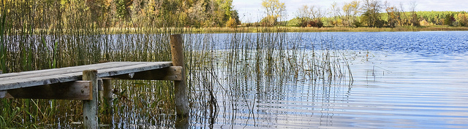
Water Quality Standards Workplan
Catherine Neuschler
Water Assessment Section Manager
Environmental Analysis and Outcomes Division

Slide 2

What is a water quality standard?
Fundamental tool of the federal Clean Water Act that focuses on waterbody condition
Based in science, with policy considerations:
What and who are we protecting? (the “use”)
What conditions are protective? (the “standard” or criteria)
How do we maintain high water quality? (“antidegradation”)

Slide 3
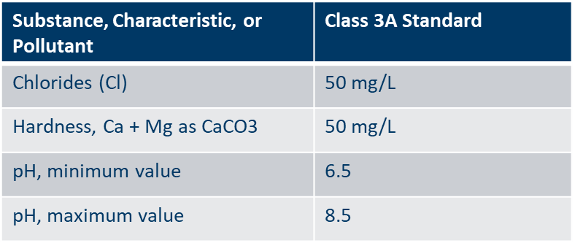
Developing Standards
1. Designate the use: What does the public value the water for?
Drinking water
Aquatic life and recreation
Industrial use and cooling
Agricultural and wildlife use
2. What type of standard will protect that use?
A statement, or “narrative standard”
“The quality…shall… permit the propagation and maintenance of a healthy community of cold water aquatic biota, and their habitats”
A “numeric standard”

Slide 4
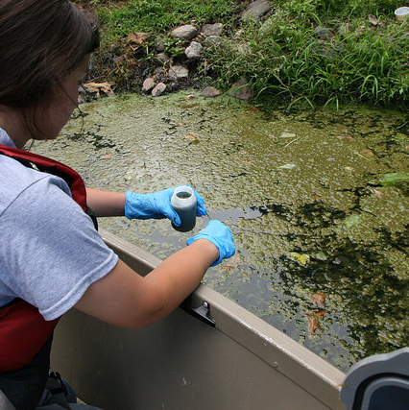
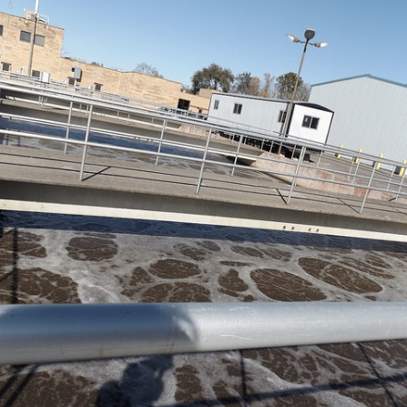
How are standards used?
To measure the health of our waters
Monitoring
Assessment
To ensure the health of our waters
Permit limits
TMDLs

Slide 5
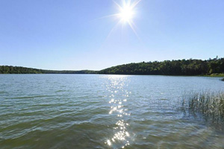
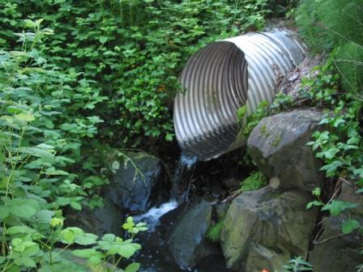
How do water quality standards feed into permit limits?
Standard
Ambient water quality goal
Lake or river water quality target
Limit
Effluent goal
Legal requirement in a permit
Typical steps:
Gather effluent data
Gather ambient water quality data
Effluent limit review
If limit is needed, consider feasibility and cost
Permit issuance
Could include a schedule of compliance or variance.

Slide 6
Updating water quality standards
The Clean Water Act requires water quality standards to reflect scientific knowledge. They evolve as science advances.
States must review their water quality standards every three years
This includes a public process
Year 1
Year 2
Year 3
Public Comment Period
Technical development
of water quality standards; formal rulemaking
MPCA Review and Prioritize

Slide 7
Water Quality Standards work plan and inventory
As part of 2017/2018 triennial review, MPCA developed a work plan for 2018 – 2020
Goal is to clearly communicate projects and where they are in the process
Divides projects into four groups
1) Current and Active Rulemaking Projects
2) Technical Development
3) Tracking and Evaluation
4) Other Projects
https://www.pca.state.mn.us/water/mpcas-water-quality-standards-work-plan-2018-2020

Slide 8
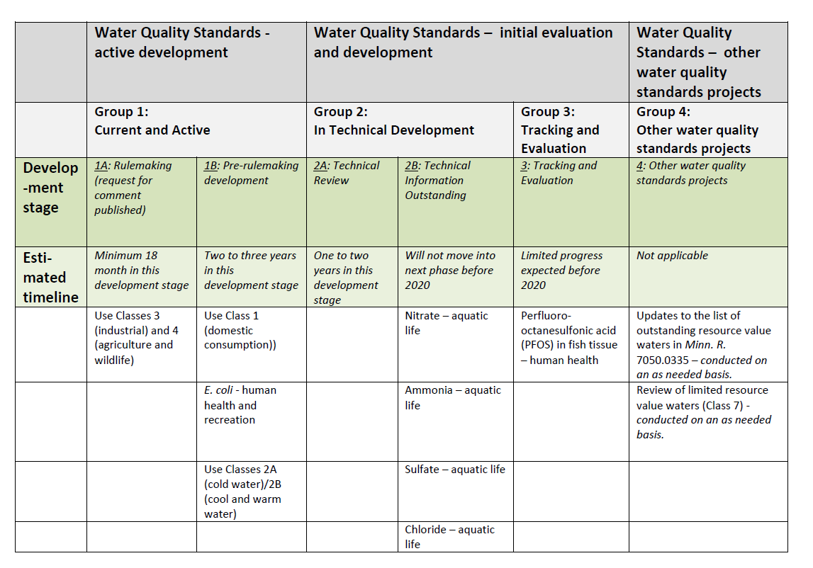
Water Quality Standards Workplan (table)

Slide 9
Water Quality Standards Development Process
Federal procedural requirements
Public notice and comment
Public “hearing”
“Duly adopted” by the state
Minnesota rulemaking process
Rulemaking is not needed for site-specific standards or criteria. Those methods have gone through rulemaking already
EPA review and approval

Slide 10
Water Quality Standards Rulemaking Process Overview
Preliminary Notice / Request for Comments
Rule and SONAR Development & Review
Notice of Intent to Adopt Rules
Public Meeting or Hearing
ALJ Review
Engagement work
File Order Adopting Rules
Final Notice of Adoption
Response to comments
Make needed rule changes
Agency and Governor’s Review
Make needed rule changes
Agency and Governor’s Review
Official Comment Period
Preliminary technical development
Develop initial TSD
Peer Review
For numeric WQS
EPA Review

